Slide 1


KS4 Mathematics
D4 Plotting moving averages

Slide 2


A graph showing number of complaints each day
This graph shows the number of times Tabina complains each day.
7
6
5
4
Number of complaints
3
2
1
0
1
2
3
4
5
6
7
8
9
10
11
12
13
14
15
16
17
18
19
20
21
22
23
24
25
26
27
28
29
30
31
32
33
34
35
Days
How well does this graph illustrate the general trend in Tabina’s behaviour?
Notes:
This graph does not show the general trend which is to complain less as time goes on. The random fluctuations (the causes of which pupils may enjoy speculating about) mask the overall improvement in behaviour. The moving average on the next slide gives a better idea of this.
The lines on the graph are dotted lines because the data is discrete (Tabina’s complaints are only counted up once a day).

Slide 3
A graph showing number of complaints each day
A line graph that shows how a value changes over time is called a time series.
To smooth out the fluctuations in this time series we can plot the moving average:
7
6
5
4
Number of complaints
3
2
1
0
1
2
3
4
5
6
7
8
9
10
11
12
13
14
15
16
17
18
19
20
21
22
23
24
25
26
27
28
29
30
31
32
33
34
35
Days
Notes:
Ask pupils to comment on the difference between the green and orange lines. The random fluctuations are smoothed out by the moving average, since any individual outlier within a group of 7 has less impact on the average than it does on its own.
Ask pupils how the graph relates back to the original question of whether Tabina is entitled to a prize: each group of 7 0s is indicated by a mean of 0, which occurs twice.
Discuss where each mean is plotted: ask why the first mean is not at the beginning of the graph.

Slide 4
Plotting moving averages on a time series graph
When we plot the moving average, each mean is plotted halfway along the group that it represents.
For our seven-point moving average we would have:
Range
Method
Position of mean on graph
1st – 7th
(1 + 7) ÷ 2
4
2nd – 8th
(2 + 8) ÷ 2
5
3rd – 9th
(3 + 9) ÷ 2
6
…
…
…
29th – 35th
(29 + 35) ÷ 2
32
Notes:
The mean is always plotted halfway along the group. To calculate its position therefore involves calculating the midpoint.

Slide 5
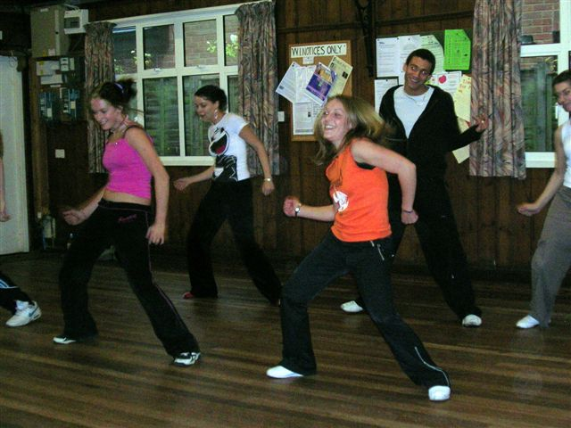
Comparing sets of data
Here are the attendance records for two hip hop dance classes of 30 students over ten weeks.
Class A
29
28
28
21
29
28
29
27
30
28
Class B
28
25
27
30
30
26
28
29
29
26
Draw line graphs for each class to represent the changes in attendance.
Notes:
Remind pupils that time always goes on the horizontal axis. They could start the vertical axis at 0, or higher. Discuss the way this will affect the apparent size of the fluctuations. What do pupils think the reason for the dip in Class A in the fourth week could be?

Slide 6
Calculating a five-point moving average
We can smooth out the fluctuations for each graph by calculating a five-point moving average.
Class A
29
29
29
29
29
29
29
28
28
28
28
28
28
28
28
28
28
28
28
28
28
21
21
21
21
21
21
21
29
29
29
29
29
29
29
28
28
28
28
28
28
28
29
29
29
29
29
29
29
27
27
27
27
27
27
27
30
30
30
30
30
30
30
28
28
28
28
28
28
28
Means for class A
27.0
26.8
27.0
26.8
28.6
28.4
Class B
28
28
28
28
28
28
28
25
25
25
25
25
25
25
27
27
27
27
27
27
27
30
30
30
30
30
30
30
30
30
30
30
30
30
30
26
26
26
26
26
26
26
28
28
28
28
28
28
28
29
29
29
29
29
29
29
29
29
29
29
29
29
29
26
26
26
26
26
26
26
Means for class B
28.0
27.6
28.2
28.6
28.4
27.6

Slide 7
Plotting a five-point moving average
Each mean is then plotted halfway along the group that it represents.
For a five-point moving average we have:
Range
Method
Position of mean on graph
1st – 5th
(1 + 7) ÷ 2
4
2nd – 6th
(2 + 8) ÷ 2
5
3rd – 7th
(3 + 9) ÷ 2
6
…
…
…
Notes:
These three examples should be sufficient for pupils to plot their own time series graph.

Slide 8
Time series for class A
30
29
28
27
Attendance
26
25
24
23
22
21
20
1
2
3
4
5
6
7
8
9
10
Weeks
Notes:
The graphs used begin their vertical scale at 20. This has the advantage of making the fluctuations clear, but could also be seen as a disadvantage since it distorts the size of the fluctuations.

Slide 9
Five-point moving average for class A
30
29
28
27
Attendance
26
25
24
23
22
21
20
1
2
3
4
5
6
7
8
9
10
Weeks
Notes:
Reinforce the purpose of the moving average. Point out the effect of the fourth week on the original graph and on the means. How many means does it affect? Does it affect the general trend?

Slide 10
Time series for class B
30
29
28
27
26
Attendance
25
24
23
22
21
20
1
2
3
4
5
6
7
8
9
10
Weeks

Slide 11
Five-point moving average for class B
30
29
28
27
26
Attendance
25
24
23
22
21
20
1
2
3
4
5
6
7
8
9
10
Weeks

Slide 12
Plotting the means for other moving averages
We can find the positions of other moving averages as follows:
Size of moving average
Method
Position of first mean on graph
3
(3 + 1) ÷ 2
2
4
(4 + 1) ÷ 2
2.5
5
(5 + 1) ÷ 2
3
6
(6 + 1) ÷ 2
3.5
7
(7 + 1) ÷ 2
4
8
(8 + 1) ÷ 2
4.5
Notes:
Ask pupils to work out what is halfway between 1 to 3, 1 to 4 etc. They should be able to generate the last column; then you can guide them to find the method in the middle column. Ask pupils if they notice any patterns in the table: the odd numbers produce integer numbers, whereas the even numbers do not. (This can be related back to the median.)
The numbers in the end column are really relative positions to the numbers along the horizontal axis. For example, if the numbers were years (say 2000, 2001, 20002 etc), then the numbers in the end column would have to be adapted.

